Slide 1
Fitness buddy
CAPSTONE PROJECT
Presented By: Tiyasa Saha
Student name : Tiyasa Saha
College Name & Department : MCKV Institute of Engineering
Information Technology

Slide 2
OUTLINE
Problem Statement
Technology used
Wow factor
End users
Result
Conclusion
Git-hub Link
Future scope
IBM Certifications

Slide 3
Problem Statement
In today’s fast-paced world, many individuals struggle to maintain a healthy lifestyle due to lack of personalized guidance, time constraints, and inconsistent motivation. Traditional fitness solutions often require expensive subscriptions, in-person consultations, or rigid schedules that don't adapt to personal preferences or daily routines.
Proposed Solution: Fitness Buddy that uses Natural Language Processing (NLP), Retrieval-Augmented Generation (RAG), is an AI-powered virtual health coach designed to help users achieve their fitness goals through personalized workout recommendations, nutrition guidance, and motivational support. It leverages IBM Cloud Lite services and IBM Granity to deliver a scalable, intelligent, and user-friendly experience.

Slide 4
Technology used
Technologies | Purpose
IBM Cloud lite services | Serverless functions for dynamic responses
IBM Watson Assistant | Chatbot for user interaction
Natural Language Processing (NLP) | Enables chatbot to understand and respond to user queries in a natural, conversational way.
Retrieval Augmented Generation (RAG) | Combines document retrieval with generative AI to provide accurate, informative, and personalized responses.
IBM Granite model | Context-aware recommendations and insights

Slide 5
IBM cloud services used
IBM Cloud Watsonx AI Studio
IBM Cloud Watsonx AI runtime
IBM Cloud Agent Lab
IBM Cloud Object Storage(Lite)
IBM Granite foundation model( Granite-3-3-8b-instruct)

Slide 6
Wow factors
Hyper-Personalized Recommendations – Tailors workouts and meals to your unique goals and lifestyle.
Smart Conversations with NLP & RAG – Understands natural language and delivers accurate, relevant health advice.
No Equipment? No Problem! – Offers effective workouts you can do anytime, anywhere, without gear.
Daily Motivation & Habit Nudges – Keeps you inspired and consistent with reminders, quotes, and challenges.
Instant Meal Ideas Based on What You Have – Suggests healthy recipes using ingredients already in your kitchen.
Seamless Integration with IBM Cloud & Granity – Runs on a secure, scalable platform with smart contextual insights.
Available 24/7 – No Appointments Needed – Always accessible for support, guidance, and motivation.
Friendly, Conversational Personality – Feels like chatting with a supportive, knowledgeable fitness buddy.

Slide 7
End users
Busy Professionals – Need quick, efficient fitness and nutrition support that fits into tight schedules.
Students – Seek affordable, easy-to-follow workouts and meal ideas to stay healthy on a budget.
Health-Conscious Seniors – Prefer gentle, guided routines and personalized wellness advice.
Fitness Enthusiasts & Beginners – Want structured plans, progress tracking, and motivational coaching.
Home Workout Users – Rely on gear-free, space-friendly exercises they can do anytime.
Weight Loss & Nutrition Seekers – Look for personalized diet tips, calorie tracking, and habit support.
Remote or Underserved Users – Benefit from accessible, 24/7 health guidance without needing a gym or trainer.

Slide 8
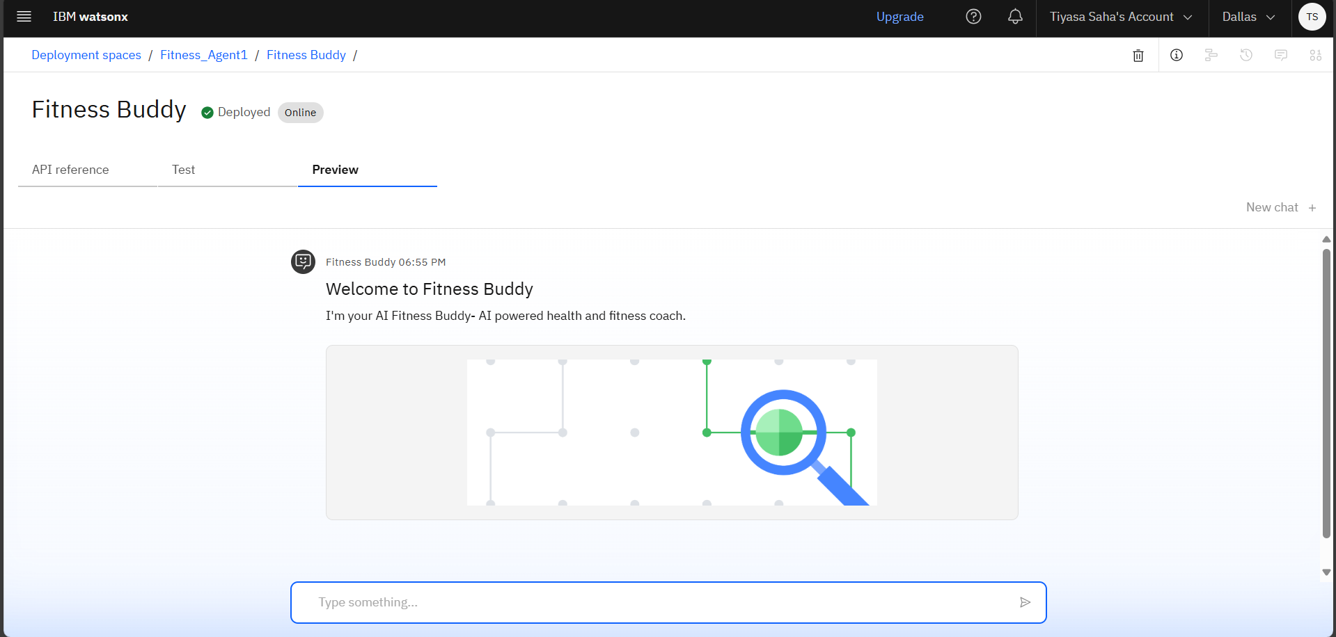
Results
Deployed AI Agent

Slide 9
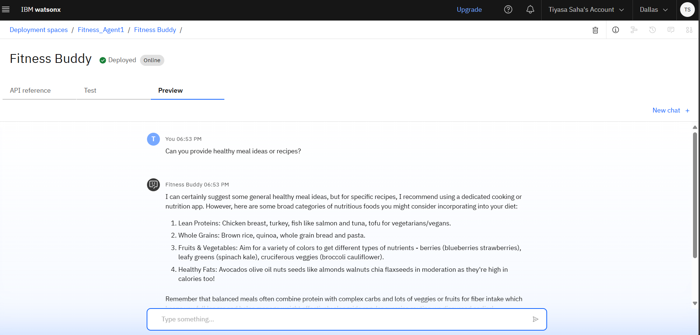
Results

Slide 10
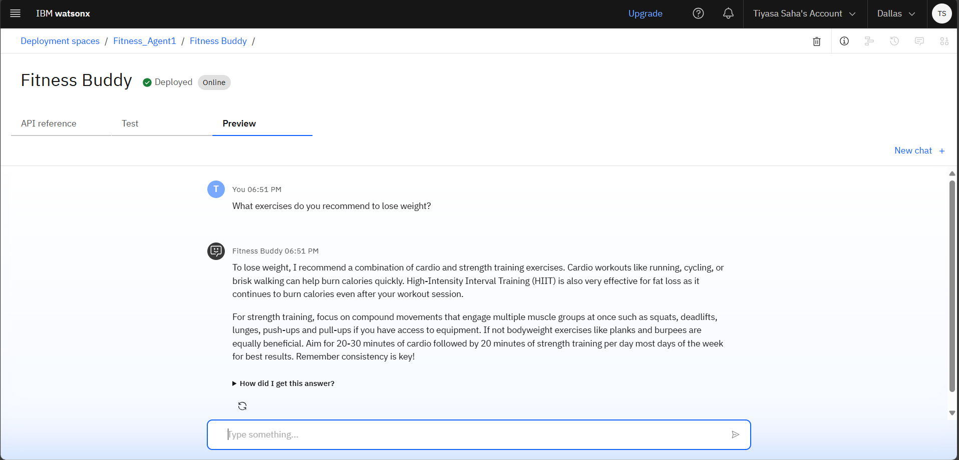
Results

Slide 11
Conclusion
User-Centric Design: Fitness Buddy provides personalized health and fitness guidance tailored to individual goals and preferences.
AI-Powered Coaching: Utilizes NLP and Retrieval-Augmented Generation (RAG) to deliver intelligent, conversational support.
Cloud-Native Architecture: Built on IBM Cloud Lite and Granity for scalability, reliability, and ease of deployment.
Always Available: Offers 24/7 access to fitness tips, routines, and motivation—anytime, anywhere.
Engaging Experience: Combines smart recommendations with friendly interaction to boost user engagement and habit formation.
Scalable & Adaptable: Designed to grow with user needs and integrate future enhancements seamlessly.

Slide 12
GitHub Link
Tiyasa7/Fitness-Buddy: Fitness Buddy that uses Natural Language Processing (NLP), Retrieval-Augmented Generation (RAG), is an AI-powered virtual health coach designed to help users achieve their fitness goals through personalized workout recommendations, nutrition guidance, and motivational support. It leverages IBM Cloud Lite services and IBM Granity .

Slide 13
Future scope
Integration with wearables
Voice assistant support
Advanced health insights using predictive analytics
Multilingual support
Gamification features
Integration with nutrition APIs
AI-powered mental wellness support

Slide 14
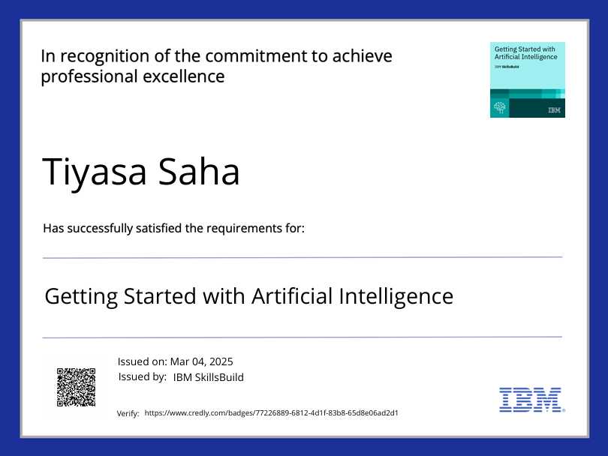
IBM Certifications

Slide 15
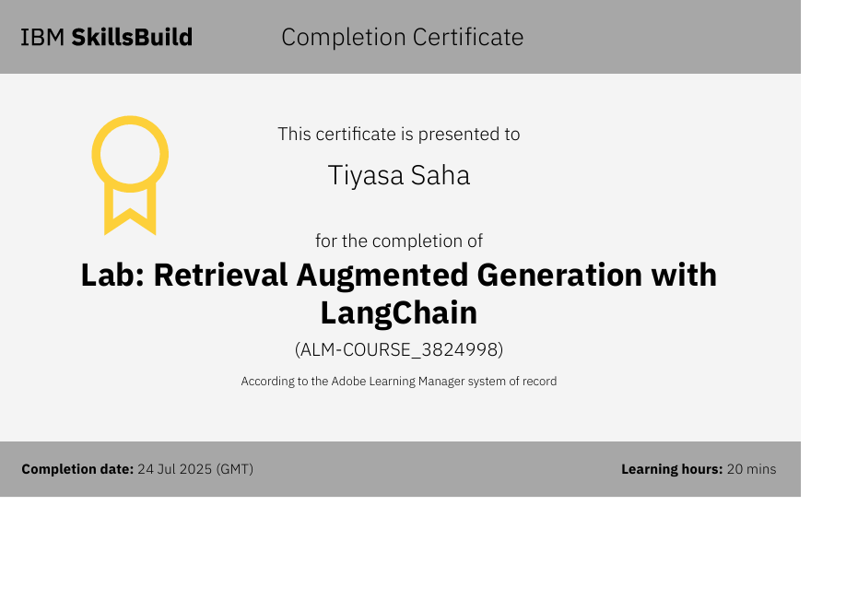

Slide 16
THANK YOU

